Slide 1
What is cyber safety?
By: Christopher Banks

Slide 2
keep your personal information private!!!
Consider What You Share In Your Profile
Think About Photos Before You Share
Check A Company’s Privacy Policy Before Buying
Watch Out For Phishing
Keep An Eye On Accounts
Be Aware of Your Internet Presence
Report Identity Theft

Slide 3
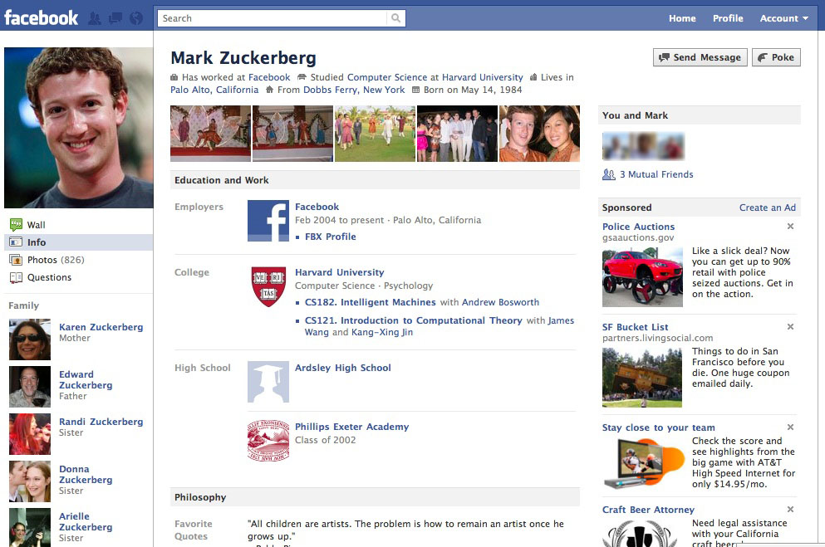
What is in your profile?
What does your profile say about you?
Is it too much information?
Is it suitable for all eyes to see?

Slide 4
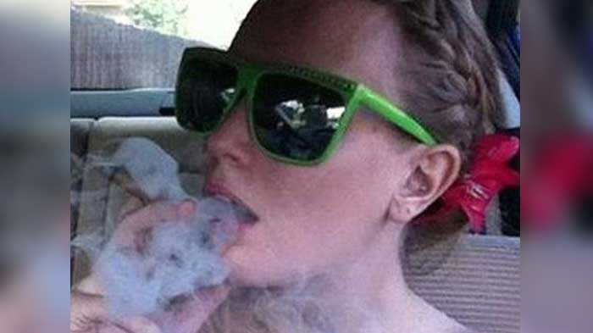
Oh, Wow! Look at that photo
Is your address in the photo? Or License plate?
Be careful not to include any identifying characteristics

Slide 5
What did their policy say?
Be careful of companies that sell your information
Ever had someone call you after you’ve made a purchase?
What about someone emailing you after a purchase?

Slide 6
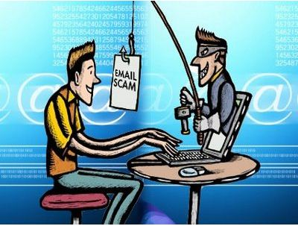
Phishing

Slide 7
What is fishing (lol)?
Phishing is a trick used by identity thieves to gain your personal information.
You will receive e-mails that appear to be from a legitimate company and asking you to confirm personal information such as bank account numbers, passwords, birth dates, or addresses.
Before adding any personal information, contact the supposed site directly to see if they have been trying to contact you.
Remember most reputable sites will not contact you in this way.

Slide 8
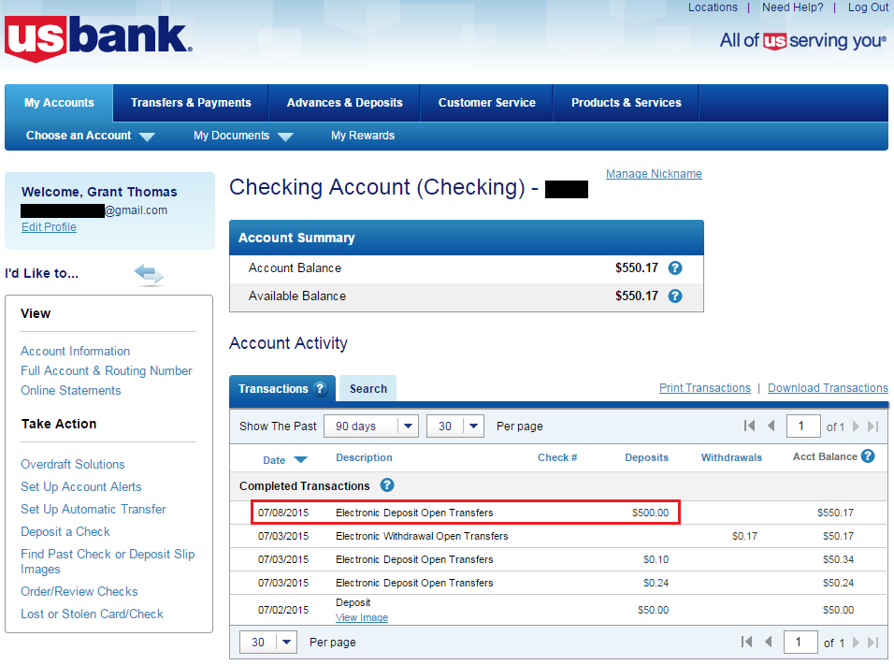
How much was that?
Check your bank account regularly (weekly/daily)
If you notice purchases that you haven't made, contact your card company immediately.
Do Not Wait to contact your bank

Slide 9
Beware!
Take the time to Google yourself
In cases of cyberstalking and identity theft, someone could use your name and information to create damaging profiles or post public messages.
Researching yourself allows you to see how others can see you

Slide 10
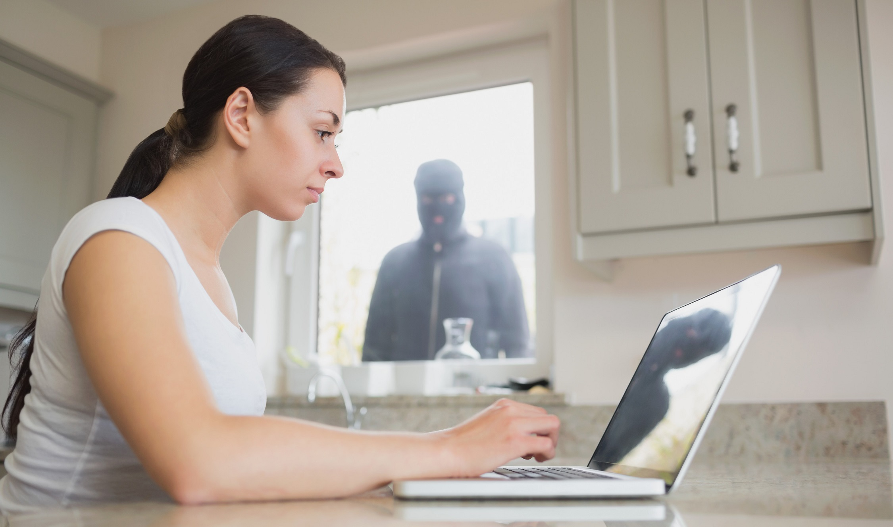
Cyber stalking

Slide 11
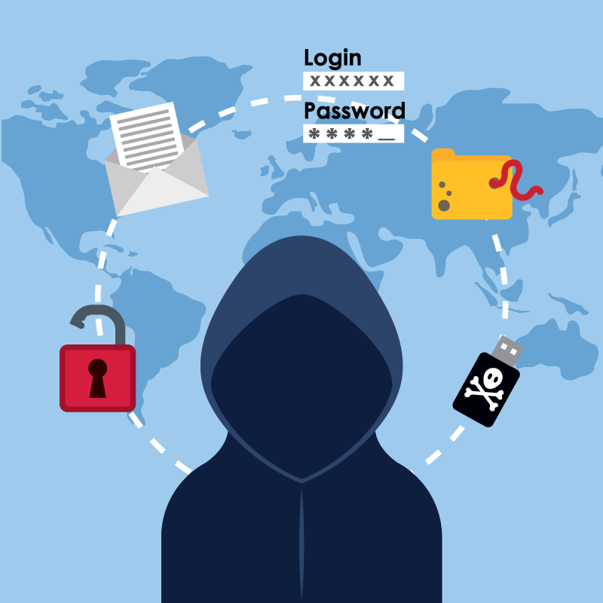
Identity theft
If you notice that someone else is using your name, credit cards, or other personal information, contact the FTC (Federal Trade Commission) right away.
You must protect your name and identity

Slide 12
Keep your accounts secure
Create Great Passwords
Don’t Reuse Passwords
Keep Your Passwords In A Safe Spot
Watch Out for Keyloggers and Malware

Slide 13
Creating a password
Do NOT choose passwords such as: your child's name, your birth date, or your favorite sports team, these kinds of passwords leave you open to identity theft and fraud.
Eight or more characters
A number, as well as letters
A special character, like %,*,@, or ?
Upper and lowercase letters
No personal information

Slide 14
Why not to reuse passwords
Avoid using the same password for different accounts
This makes multiple accounts vulnerable if your password is discovered.

Slide 15
Keeping your passwords safe
The safest place to store your password list is on an external flash drive that you keep with you.

Slide 16
Keyloggers and malware
Certain computer programs, called key loggers, can keep track of the keys you type and transmit this information to those who might want to steal your information
Make sure your security programs are up to date
Be careful when entering passwords in public

Slide 17
STAY Vigilant
Think Before You Open Email Attachments
Consider the Legitimacy of Free Programs
Keep Your Virus Software Up-To-Date
Watch for Fraud
Be On The Lookout For Sexual Predators

Slide 18
Think before opening
Don't open email attachments from people you don't know.
These attachments may contain viruses or other malware. Additionally, think twice before you open an attachment from someone you do know.
It's common for email accounts to get hacked, and the hackers may send messages and attachments to all of the people in the address book.
If it doesn't sound like something your friend might send you, email him or her separately to find out if it's legit.

Slide 19
But its free
Avoid downloading free software online unless you're certain it's from a reputable company.
Many free programs are merely a device for delivering adware and spyware.

Slide 20
Update
Install virus protection software and a firewall. Check for updates regularly.

Slide 21
Watch for fraud
Some of the most common forms of Internet fraud include the following:
Online auctions site postings that feature non-existent or falsely represented merchandise
Nigerian money offers promising large sums of cash in exchange for assistance with bank account transfers
Financial scams targeting consumers with poor credit who are tricked into paying upfront fees in hopes of receiving credit cards or personal loans
Phony sweepstakes offers asking for payment to claim a prize that doesn't really exist

Slide 22
Sexual predators
If you're a single woman who likes to use online dating sites, be on the lookout for potential sexual predators.
It's not always easy to tell if a potential date is merely lying about his appearance or trying to conceal a criminal past.
If you do decide to arrange a personal meeting with someone you met online, always request that your first date be in a restaurant or similar public place.
It's also a good idea to tell a friend where you're going and make sure someone is available to check up on you later in the evening.

Slide 23
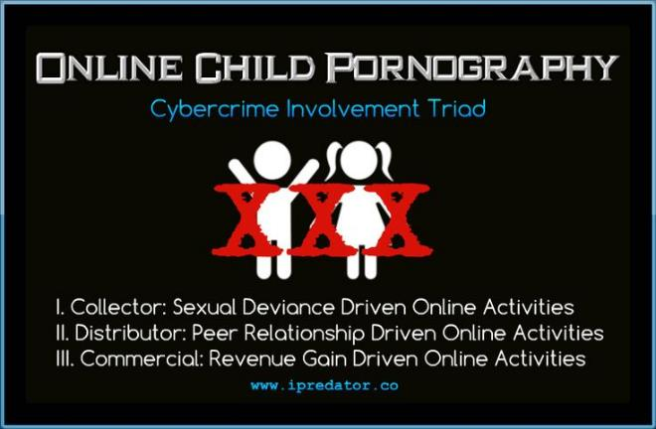
Sexual predator

